Slide 1
CRITICAL EVALUATION OF JOURNAL ARTICLE
DR.G.AARTHIPRIYANKA
POST GRADUATE
DEPARTMENT OF PHARMACOLOGY

Slide 2
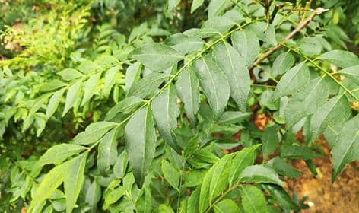
TITLE:
Antihyperglycemic Activity of Murraya koenigii Leaves Extract on Blood Sugar Level in Streptozotocin-Nicotinamide Induced Diabetes in Rats
Biomedical & Pharmacology Journal, June 2019.
SUGGESTED TITLE:
The author could have specified Wistar rats in his title.

Slide 3
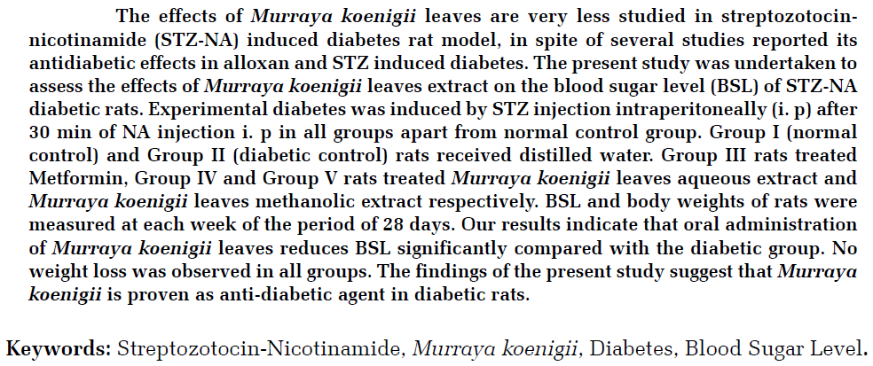

ABSTRACT
Research Objective & Key methods
Type of extract used
Principle Finding
study conclusion
dosage of extract used
Species & sex of animal used

Slide 4
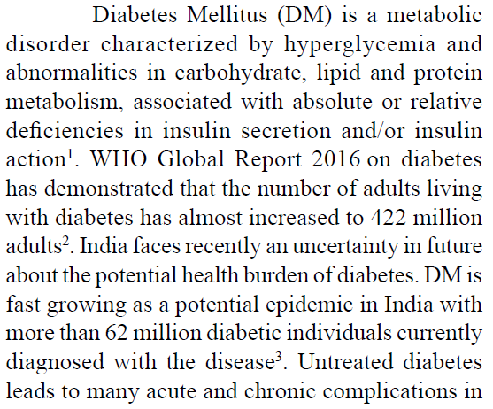
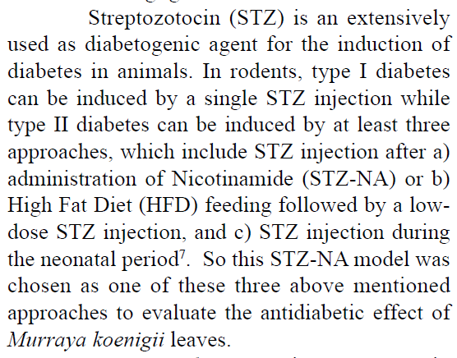
INTRODUCTION . Background
Explained the rationale of why this disease has been taken up for the study
Explained the reason for this diabetic model

Slide 5
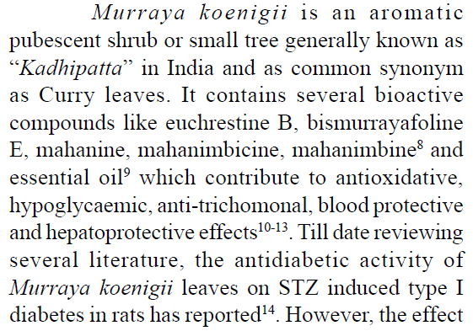
INTRODUCTION
Why this leaf extract and its other properties with references are mentioned.
Rationale of using the animal species and its study relevance to human biology.

Slide 6
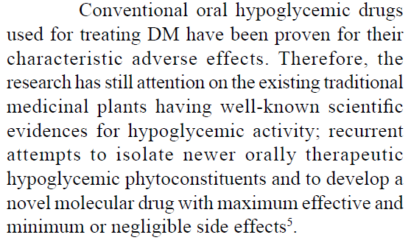
INTRODUCTION
Explained the rationale
of why this study

Slide 7
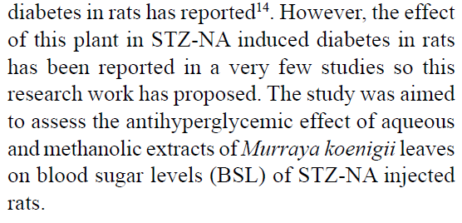
Objective
Mentioned objective
at the end of introduction
Primary & secondary objectives – not specified

Slide 8
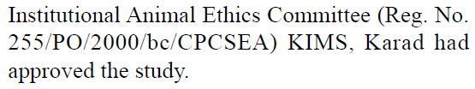

METHODS
Ethical Statement
Ethical committee approval

Slide 9
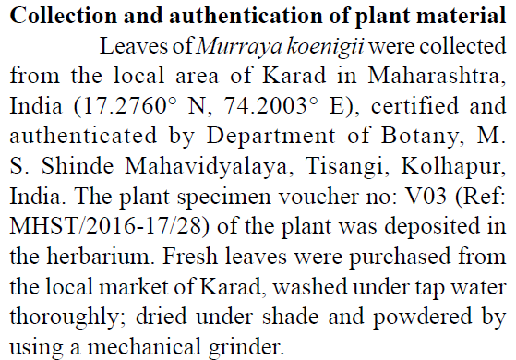
METHODS
Background of Plant materials

Slide 10
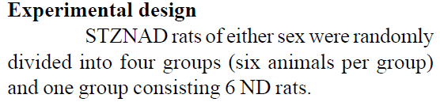
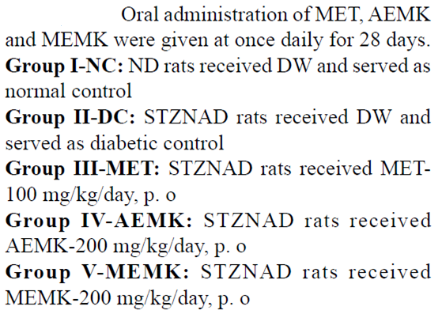
Study design
Experimental units
Number of experimental
control groups

Slide 11




Experimental Procedure
Drug formulation and dose
Site and route of administration
Timing of administration
Method of Euthanasia

Slide 12
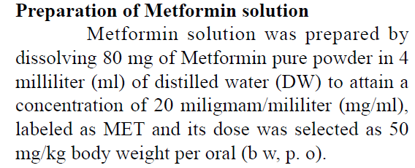


Drug formulation and dose - Metformin

Slide 13
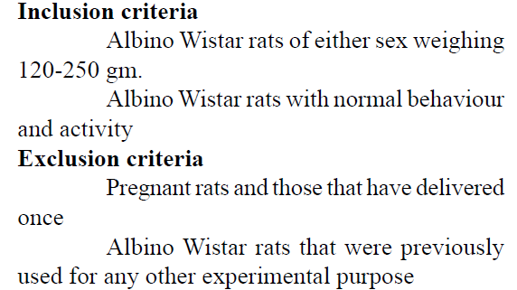
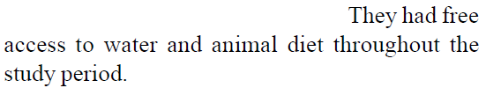
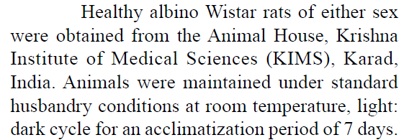
Experimental Animals
Species
Sex of the animal
Weight
Source of Animal
Genetic Modification Status, Genotype, Immune Status, Drug or test naïve
Inclusion & exclusion criteria - mentioned
Housing & Husbandry
Temperature
Type of food
Access to food and water
Type of facility

Slide 14
Sample Size
Total Number of Animals in each experiment and each experimental group.
Allocation of Animals
Randomisation or matching

Slide 15
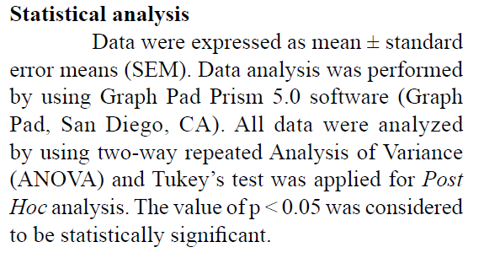
Statistical Methods

Slide 16
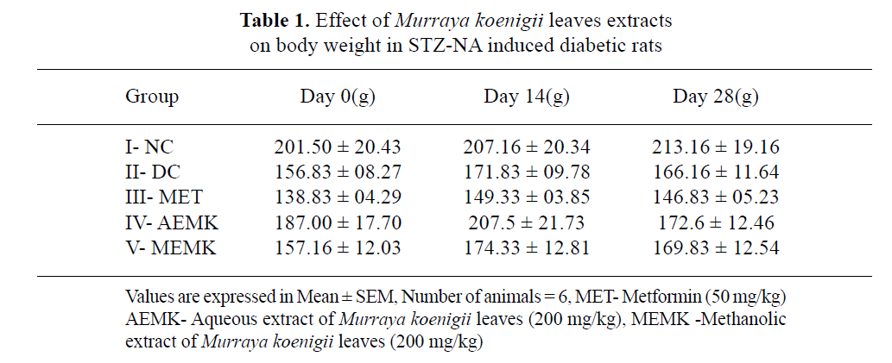
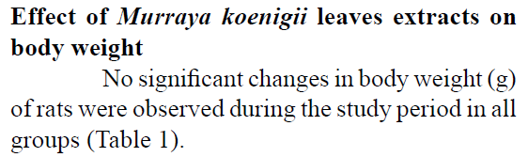
Experimental Outcomes

Slide 17
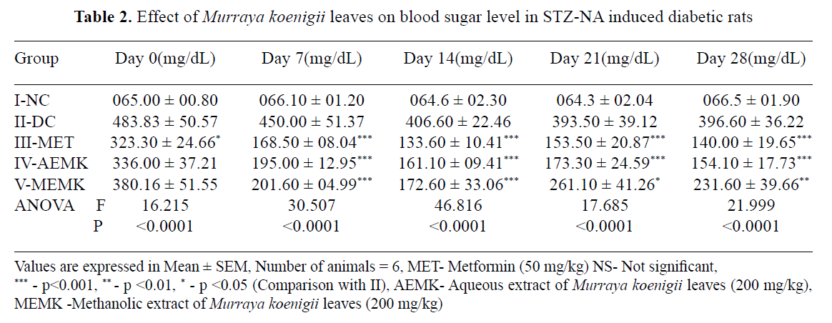
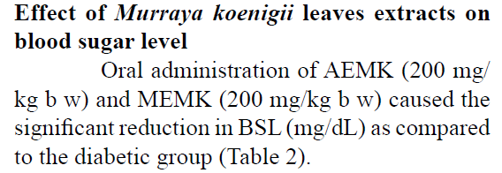

Slide 18
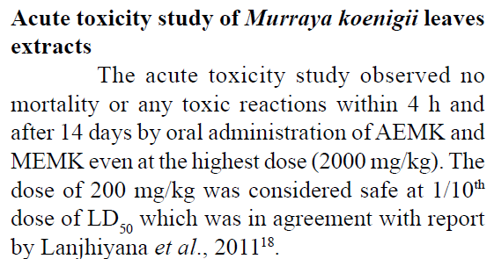
TOXICITY STUDY

Slide 19
RESULTS
Baseline Data - Explained
Numbers Analysed - Absolute number of animals in each group are reported
Outcomes and Estimation - Results for each analysis are carried out with a laboratory analysis
Adverse Event - not reported

Slide 20

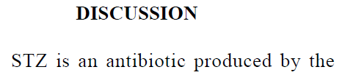
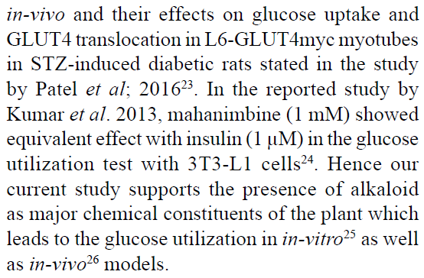
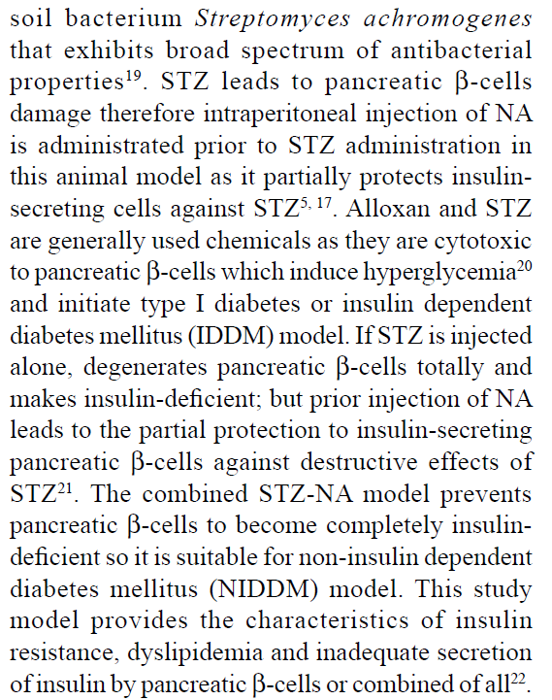

Slide 21
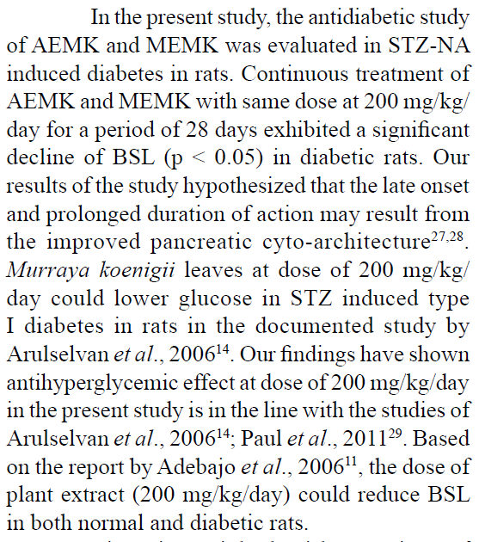
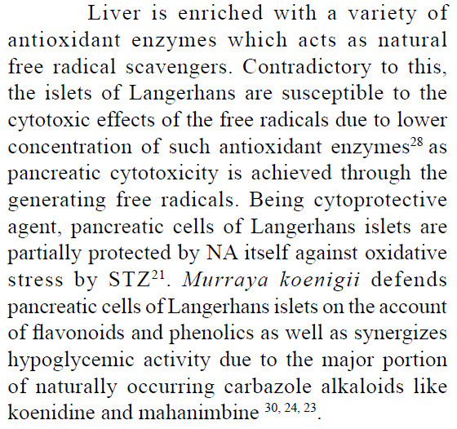

Slide 22
DISCUSSION
Interpretation
The results of this study were not precisely interpreted.
Study Limitation- not defined
Generalizability
Funding
Funding sources are not mentioned
REFERENCE
Vancouver style followed

Slide 23
THANK YOU

